Slide 1
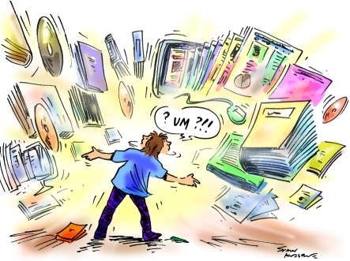
Using Databases
Cileno, 2014

Slide 2
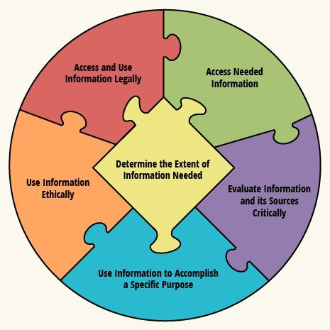

Slide 3
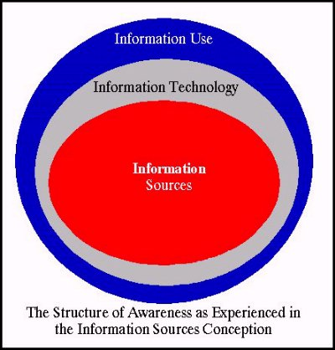
A database is a collection of sources
Books (print, ebook, or book/chapter reprinted in a website)
Magazines (Online or Print)
Pamphlet, Diary, Broadside,
Interview
Speech
Image or Painting
Film Clip

Slide 4
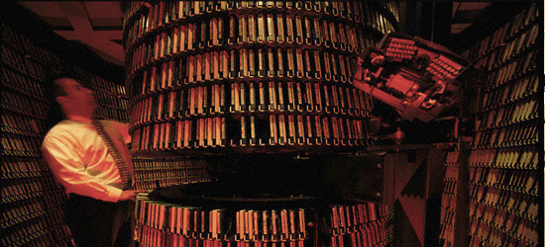
A database is part of the Closed Web
Libraries pay for the cost of information databases, and sometimes need a password.
Sources within a database are from previously printed sources which have been digitized to be searchable by subject heading.
An information database has millions of sources, with billions of pages of information

Slide 5
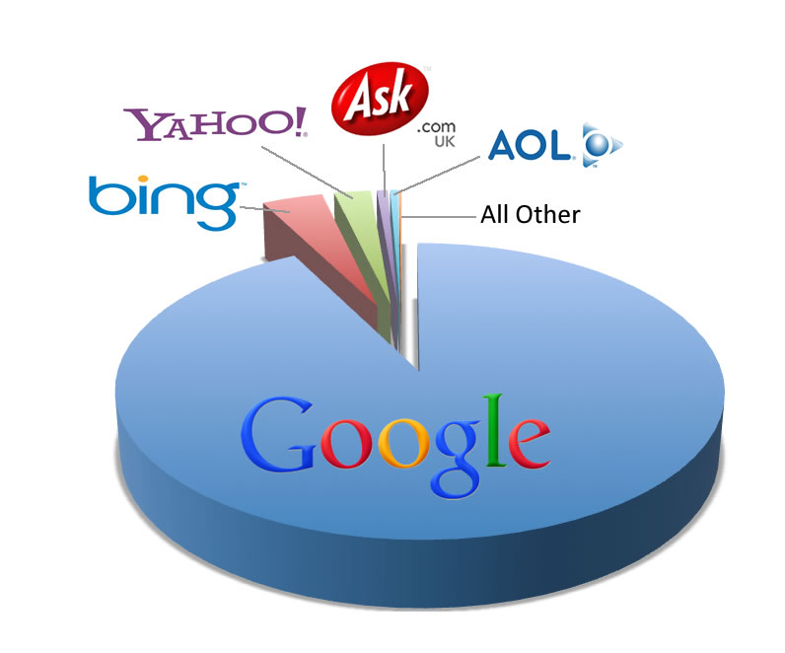
Webpages are part of the Open Web
Google searches for key words in web pages which reside on servers on the Internet. In this case your source is the webpage in the website where your information is.

Slide 6
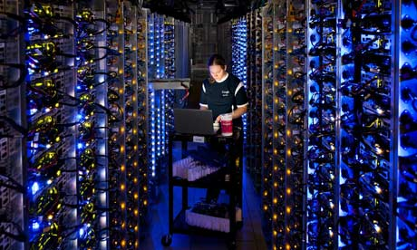
How Many Sources Are There?!
The Library of Congress, just one, has 158 million items, including 36 million books, 3.5database million recordings, 13.7 million photographs, 5.5 million maps, 6.7 million pieces of sheet music, and 69 million manuscripts- many are primary sources.
The LOC adds 12,000 materials every day- American Memory Project
Only 10% of the world’s information has is available on the web

Slide 7
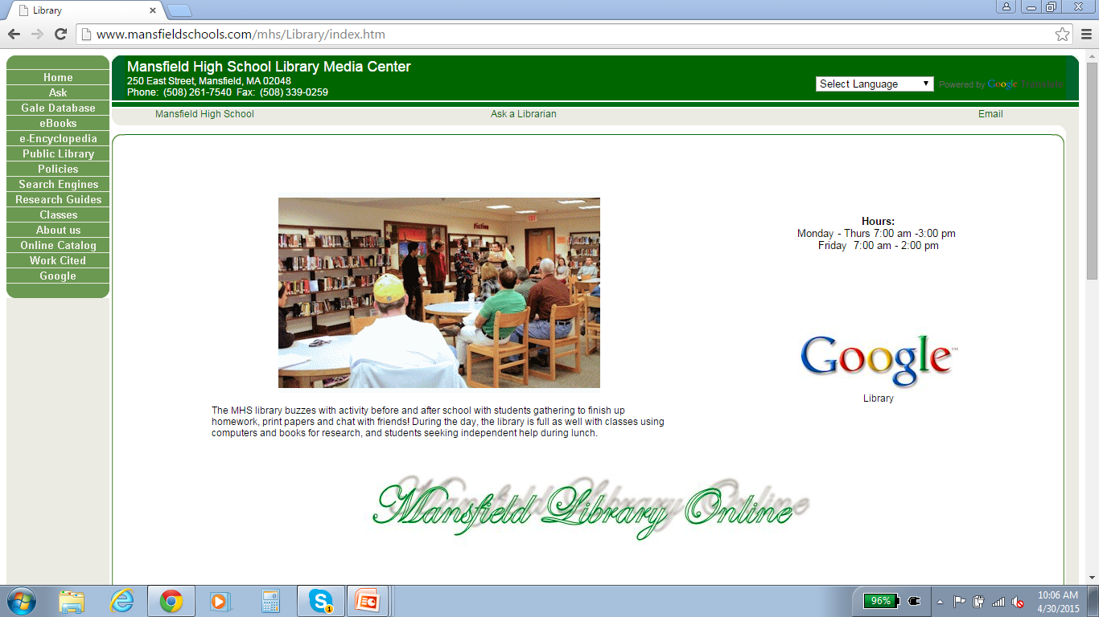
Mansfield High School Library
Gale Database

Slide 8
Gale Databases

Slide 9
Science in Context

Slide 10
Search Results

Slide 11
Refining Search Results

Slide 12
Database Tools

Slide 13
The End (for now)

